Slide 1
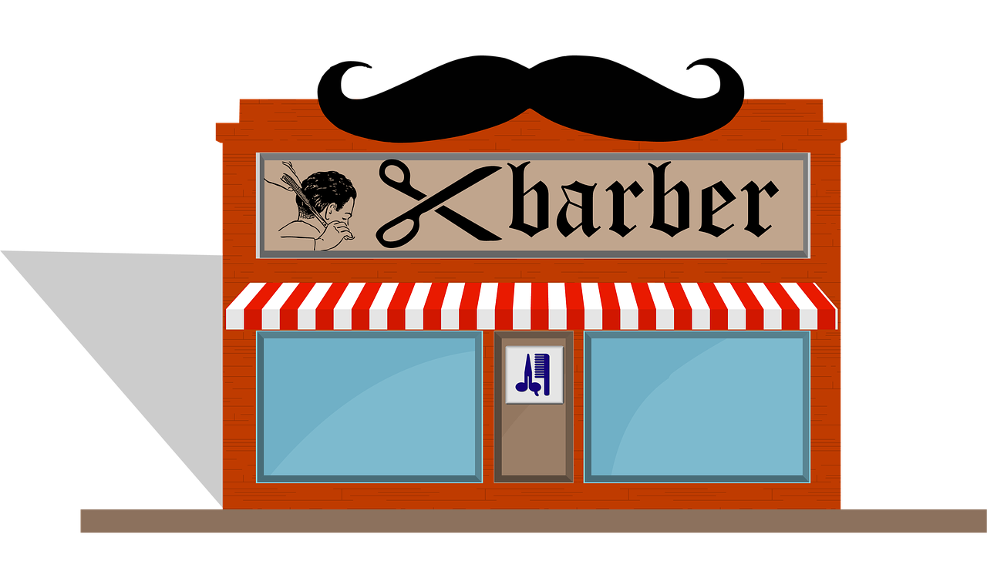
Choose Your Own Adventure
Learn about business finance and opportunity cost!
Notes:
Coffee shop? Diner? Clothing store? Hairdresser? Bookstore?

Slide 2
Your Challenge:
You are the owner of a hair salon, Budget Cuts! It’s the end of the year, and you have some money leftover that you want to use to buy new equipment to improve your business for next year.
There are a number of things that you want to invest in, but you only have $2000. What will you buy?

Slide 3
Instructions:
Read the following item descriptions and think about the benefits of each potential purchase.
On Slide 13, write which items you will purchase and their total cost, which can add up to a maximum of $2000.
On Slide 14, write 3-5 bullet points to explain why you chose the items you did.

Slide 4

Benefits of this buy:
Currently, your hair salon only owns one hair dryer, which slows down your operations since only 1 staff member can use it at a time.
Your other tools are also starting to look worn out. Specifically your set of scissors are starting to rust and are getting dull.
If you were to buy more tools, you would increase the speed of serving each client, and save money on the hairdresser's wages since they can to work more efficiently.
New Tools
$300

Slide 5

Benefits of this buy:
With this purchase, you will be able to fulfill more customer appointments each day. Your manager has stated that she would like to increase the capacity of your store.
You currently have 2 chairs in the store, so you can only serve 2 clients at a time and the others have to wait in line.
Styling Chairs
$400 each

Slide 6

Benefits of this buy:
You’ve noticed that you’re running low on hair products like shampoo, conditioner, and hair dye.
You’re thinking of stocking up on these products to reduce the number of trips to the store in the future to save time, but the prices right now are higher than usual.
If you buy it now, you won’t need to worry about running out of products.
Hair Products
$300

Slide 7

Benefits of this buy:
Your manager has decided that she wants to increase the amount of clients that your salon serves. Hiring new staff would give you the human resources needed to achieve this goal.
Currently, you have 2 hairdressers. Without hiring at least 1 new staff, your current hairdressers would likely have to work overtime hours, which would be very tiring.
You may hire up to 3 new staff. Any more than that would not be needed.
Hire Employees
$500 each

Slide 8

Benefits of this buy:
The mirrors you have right now were given to you by the previous owners and therefore are quite old-looking. Some of them have been getting a bit foggy and one of them has a crack.
By replacing your mirrors, you’ll be giving your store a slight modern flare, which will help improve customer experience and overall atmosphere of the place.
New Mirrors
$200

Slide 9

Benefits of this buy:
Your salon currently does not have a waiting area and customers would have to stand in line. Those accompanying the clients also have no place to sit.
This addition would increase customer satisfaction and comfort, which will in turn improve their reviews.
You also expect that with this change, your amount of tips would increase.
Seating Area
$500

Slide 10

Benefits of this buy:
Upgrading the look of your hair salon from the outside would help attract new customers to come visit your store.
Your current storefront is looking a bit outdated, and it’s hard for customers to see your store when they are driving by.
Your manager believes that this upgrade would be really beneficial to gaining new customers.
Exterior Renovation
$800

Slide 11

Benefits of this buy:
You recently have been getting customer complains about the overall cleanliness and atmosphere of the store. One customer left a bad review about the chairs being constantly dirty.
Your manager has taken this review seriously and has recommended that we resolve this issue quickly.
Purchasing cleaning supplies will help with overall customer satisfaction and cleanliness of your hair salon.
Cleaning Supplies
$100

Slide 12

Benefits of this option:
If you choose not to use your full budget to buy new equipment, you can instead save your money for next year.
This would provide your hair salon with some “wiggle room” in case you have some unexpected costs this upcoming year--such as if something breaks and you need to replace it later on.
Or, it would simply provide you with more money to use to buy equipment next year!
Save Your Money

Slide 13
Which items will you choose? List them here, along with their prices! Then, add up the total cost of your purchases (must be $2000 or less).

Slide 14
In 3-5 bullet points, explain why you chose the items you chose:

